Slide 1
Synthetıc lego ımage data classıfıcatıon analysıs
Kaan Can
090190311

Slide 2
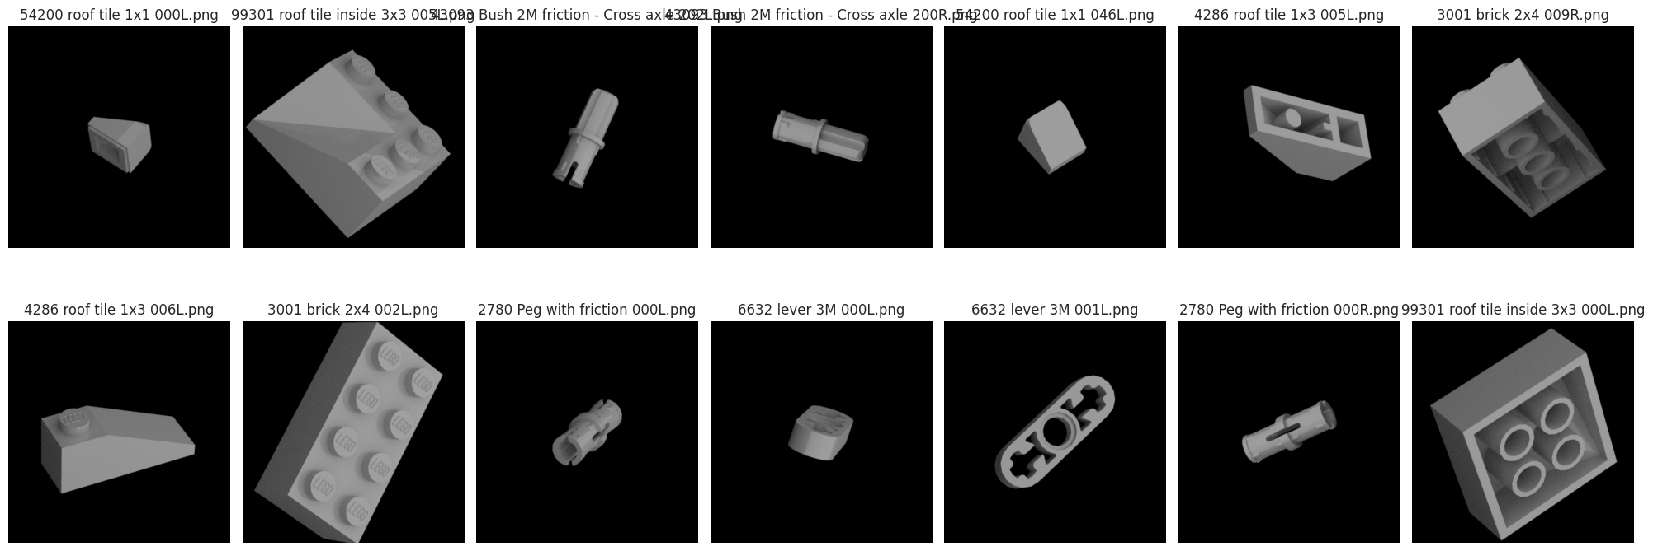
Data set ıntroductıon

Slide 3
Problem defınıtıon
No numerical, nominal, ordinal features along with the dataset, only images.
Need to correctly multi-classify & predict LEGO images

Slide 4


solutıon
FEATURE EXTRAXTION
The aim of the project is extract features from images and classify them using machine learning algorithms.
IMAGE PROCESSING TOOLS

Slide 5
Feature extractıon
SHAPE
AREA
Detected shape of the LEGO piece
Calculated area of the LEGO piece shape
SCORE
PERCENT
Pixel length of the longest line detected in the LEGO piece
The comparability ratio between longest line and original image
CIRCLES
NUMER OF LINE
Number of circles detected in the LEGO piece
Number of corectly detected lines in the LEGO piece
NUMBER OF CORNERS
Number of corners detected in the LEGO piece

Slide 6
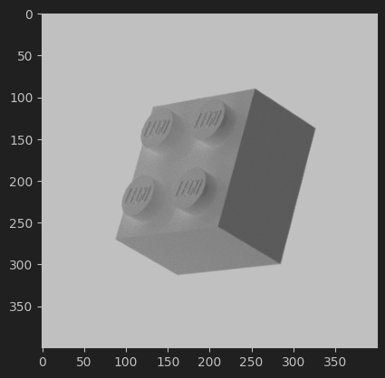
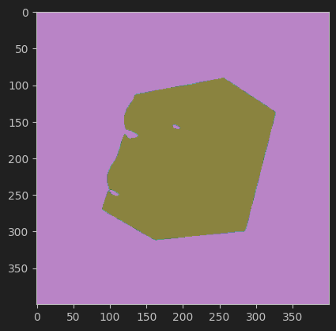
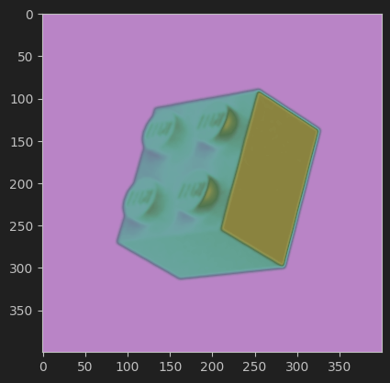
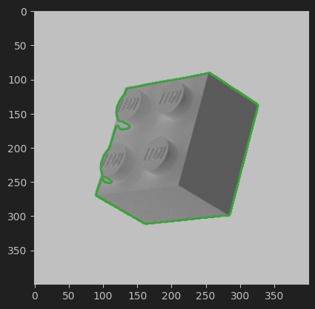
SHAPE DETECTION

Slide 7

AREA DETECTION

Slide 8
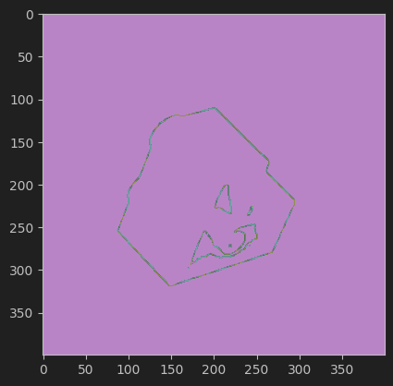
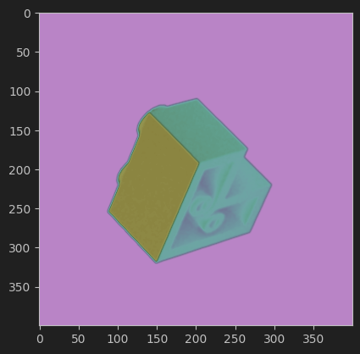
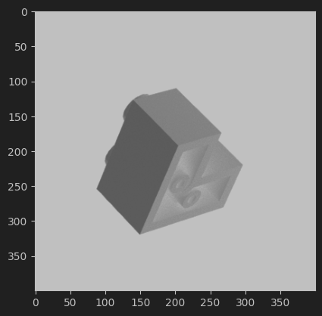
Longest lıne DETECTION

Slide 9
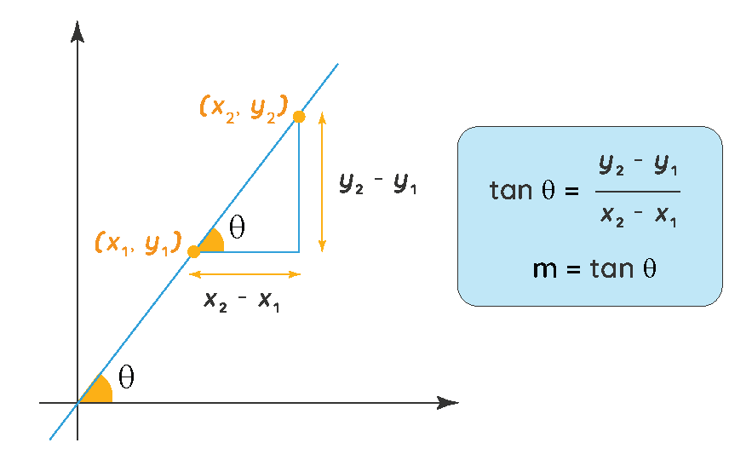
Lıne success rate DETECTION

Slide 10
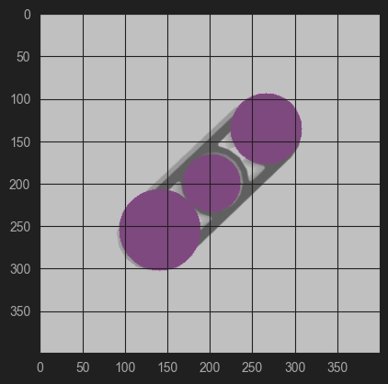
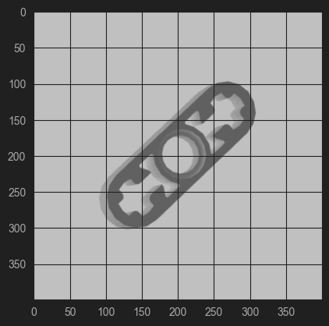
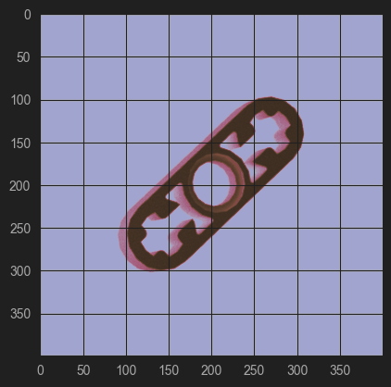
cırcle DETECTION

Slide 11
Detected Number of lıne
Detected number of corners

Slide 12
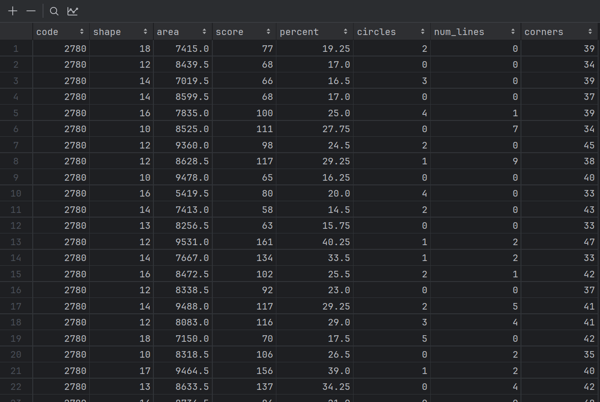
new data set

Slide 13
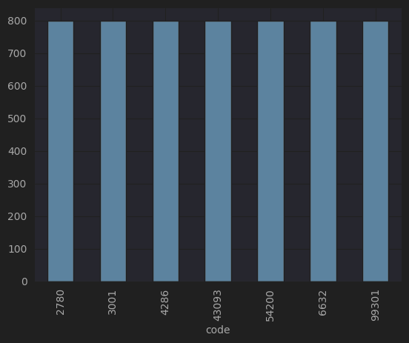
Target analysıs

Slide 14
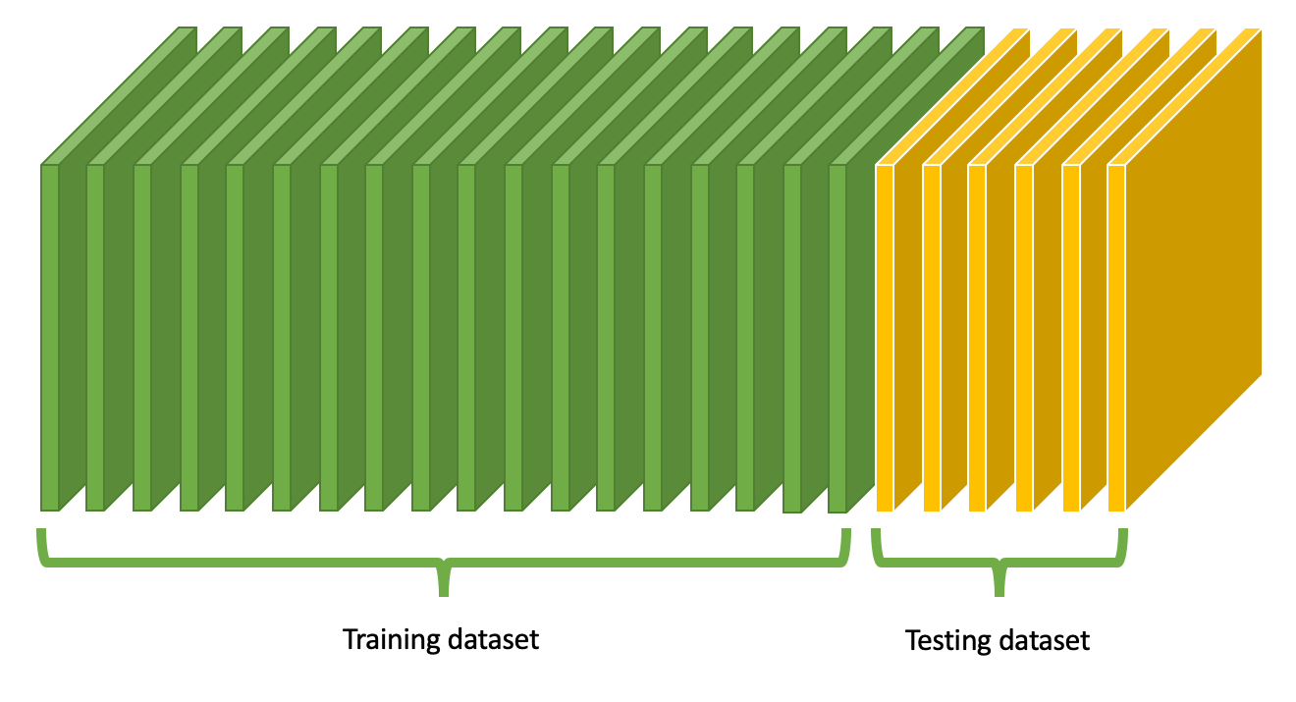
Data leakage problem

Slide 15
Mıssıng values
14
NAN
103

Slide 16
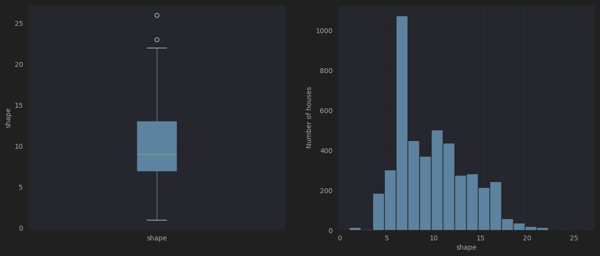
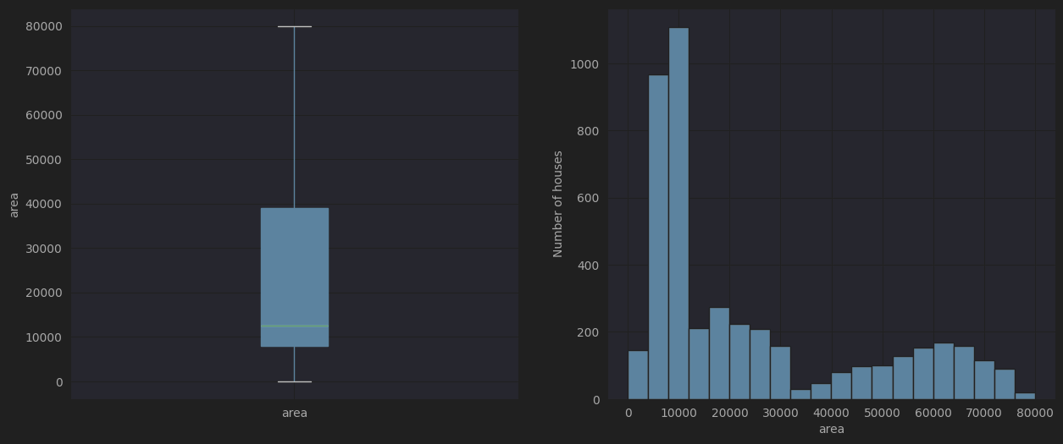
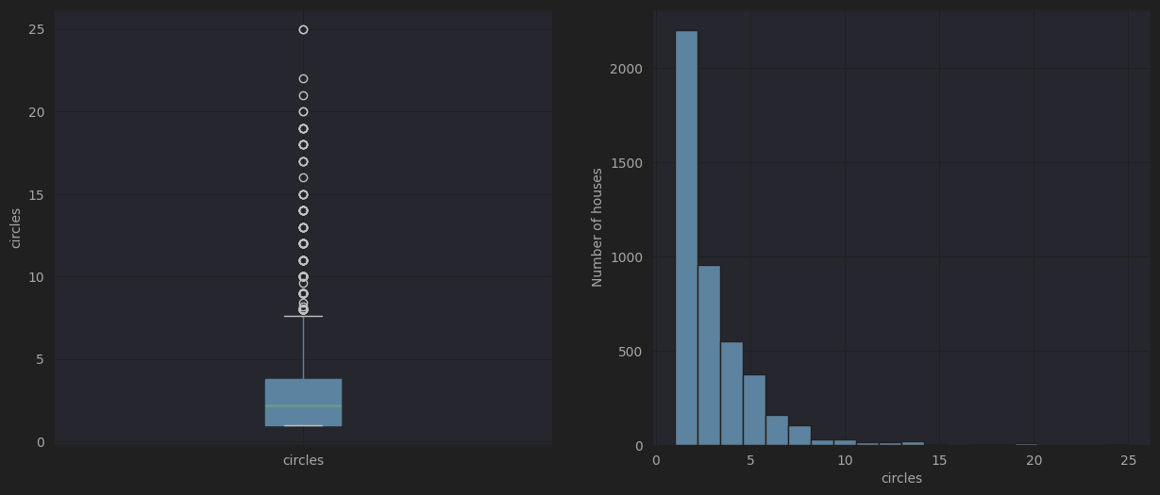
Outlıer managment

Slide 17
encodıng

Slide 18
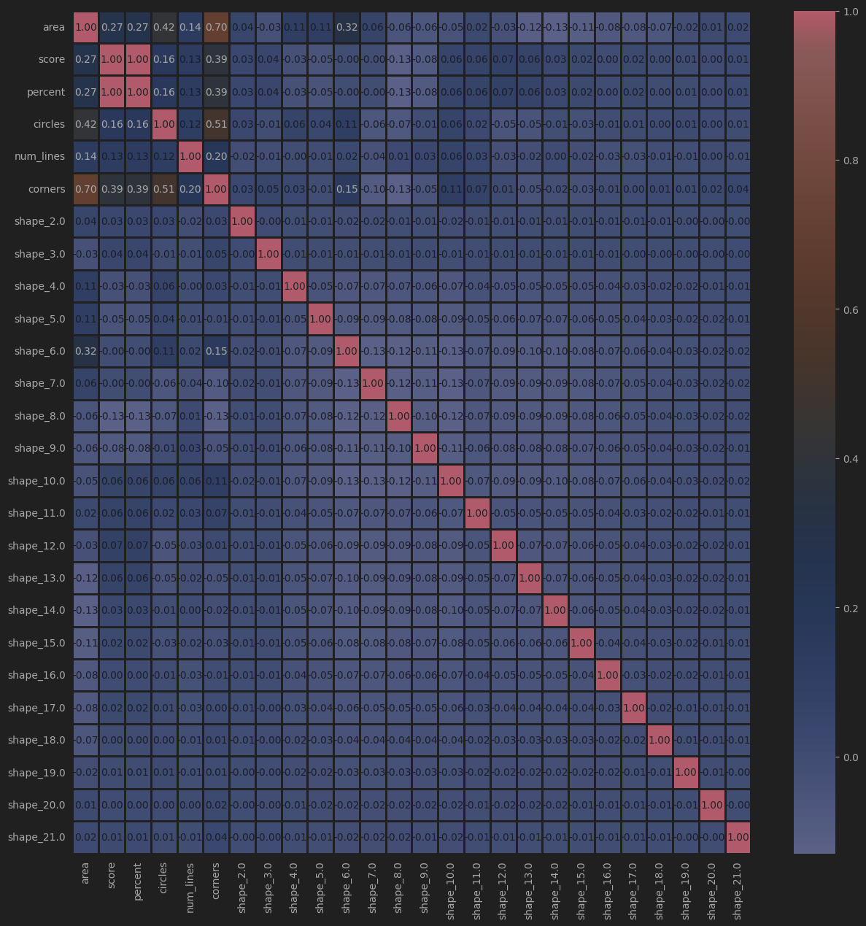
Multıcorolaty

Slide 19
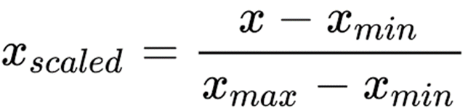
scalıng

Slide 20
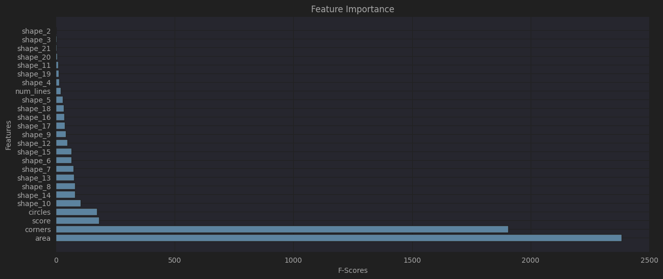
Seleckt 15 best features

Slide 21
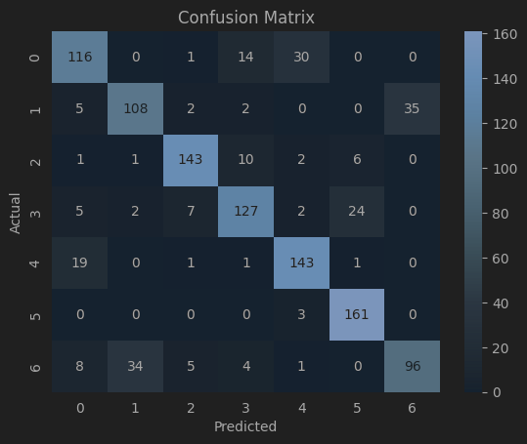
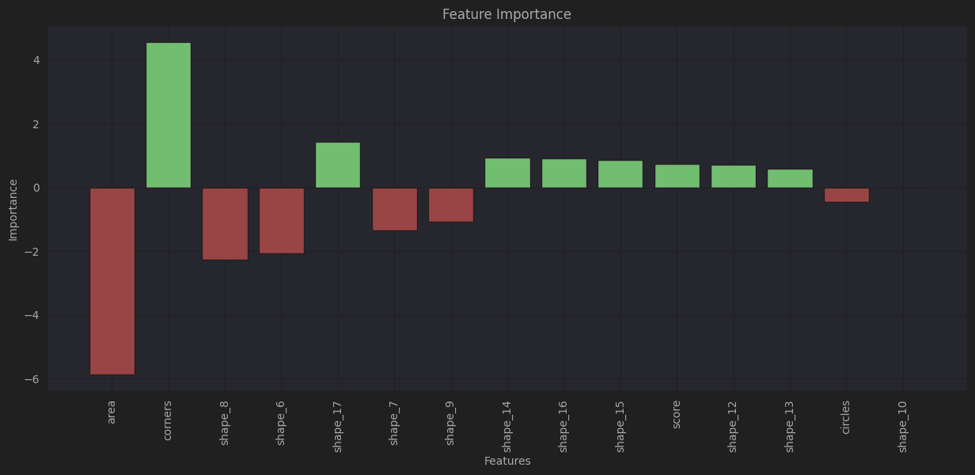
Logıstıc regressıon
TRAIN: %80
TEST: %79

Slide 22
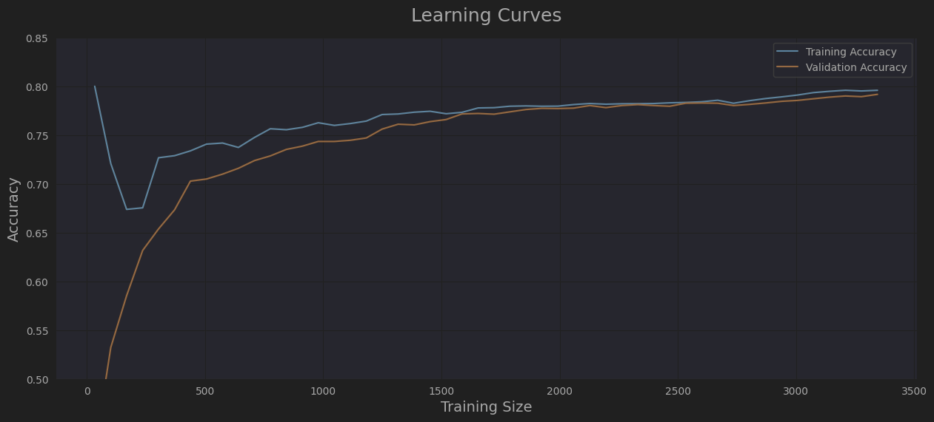
Logıstıc regressıon
TRAIN: %80
TEST: %79

Slide 23
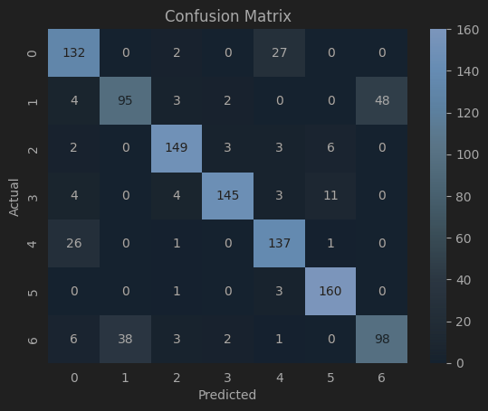
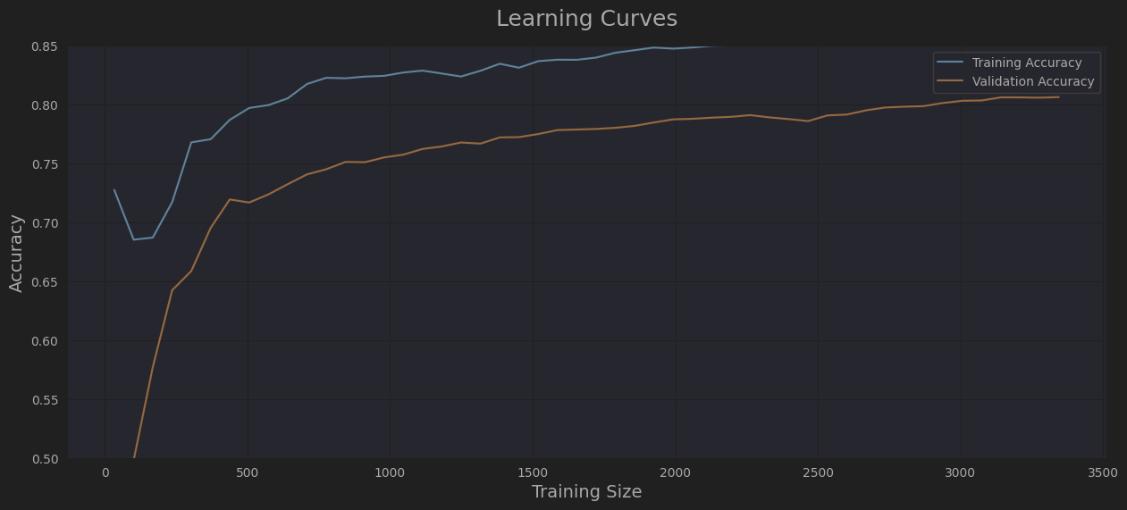
K-NEAREST NEIGHBORS
TRAIN: %86,6
TEST: %81,7

Slide 24
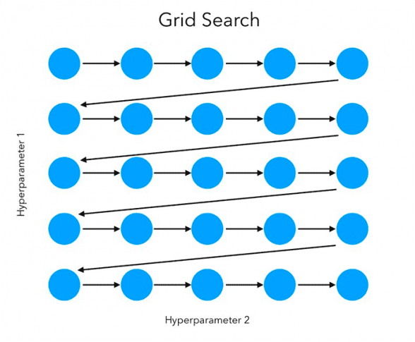
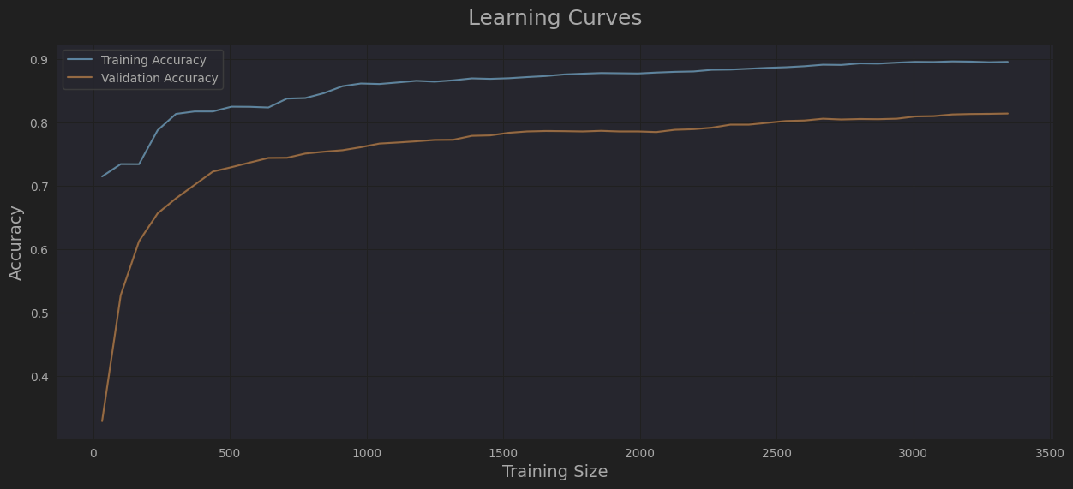
GRID SEARCH
TEST: %82,6
TRAIN: %90

Slide 25
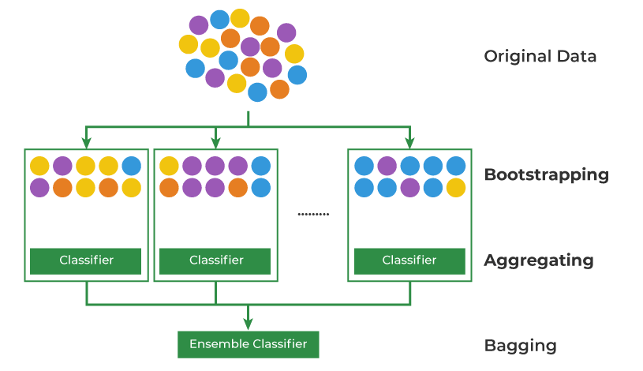
Baggıng classıfıer
TRAIN: %91,1
TEST: %83

Slide 26
results

Slide 27
Thanks
Kaan Can
090190311
cank19@itu.edu.tr

